Slide 1
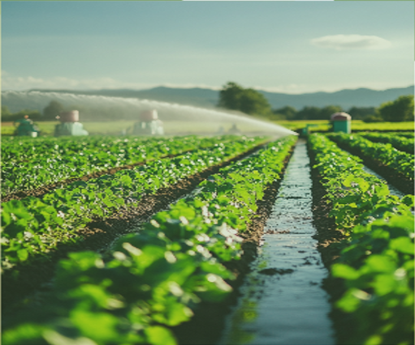

p
AI Revolution in Water Recycling: Intelligence into Irrigation
Prepared By:
Fahima Abida Chowdhury
B.Sc. in Computer Science and Engineering (CSE)
University of Information Technology & Sciences
Email: 0432220005101135@uits.edu.bd

Slide 2
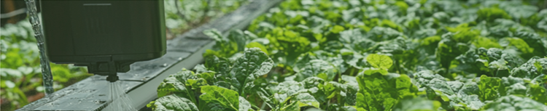
The Growing Global Water Crisis: Why Innovation Matters ?
Increasing Demand
Population growth, urbanization, and changing
consumption patterns
Limited Resources
Climate change, pollution, and over-extraction
Understanding Greywater and Saltwater Recycling Basic
Greywater Saltwater
Sources- showers, sinks, laundry and dishwashing From oceans, desalination, and industrial processes
2

Slide 3
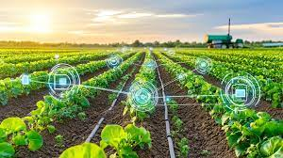
AI-Powered Smart Irrigation Introduction
2
AI In Saltwater Filtration
AI optimizes desalination,
reducing energy use & costs, while improving water quality and maintenance.
Ensuring a reliable freshwater supply.
Greywater Utilization
Using greywater recycling allows farmers to reuse household wastewater. This reduces the need for freshwater and helps create a more circular water economy.
1
4
Water Savings
Cut freshwater use by 30-50% in farming. This helps make agriculture more sustainable.
Automated Monitoring
IoT sensors watch soil conditions and weather in real-time. This makes irrigation more effective. Farmers can adjust watering schedules at the right time to give crops the water they need.
3
3
3

Slide 4
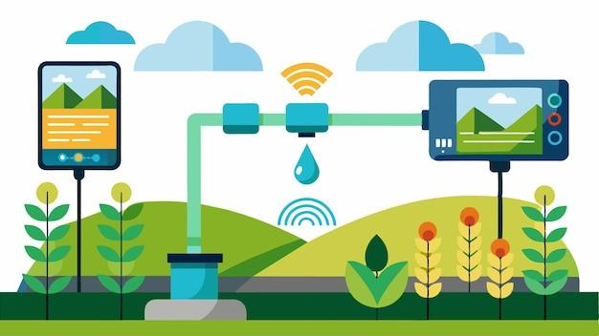
Key Technologies and Components
AI Tools provides information to ensure effective water use by optimising irrigation and saltwater filtration.
Internet of Things (IoT) Sensors helps with real-time irrigation and filtration adjustments by monitoring soil moisture and ambient variables.
Saltwater Filtration Using Automation and AI AI balances energy consumption and irrigation water quality by
optimising desalination operations.
System of Filtration safely purifies seawater and greywater for irrigation usage.
Dashboard for Mobile enables alarms and remote monitoring for simple system
maintenance and modification.
4

Slide 5
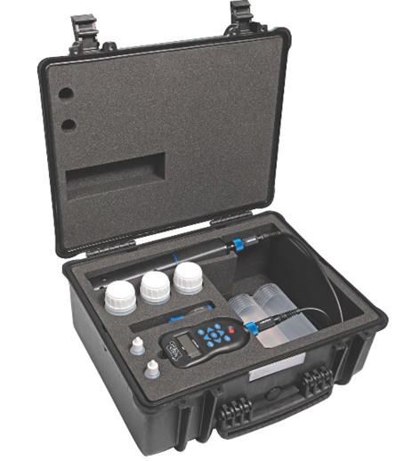
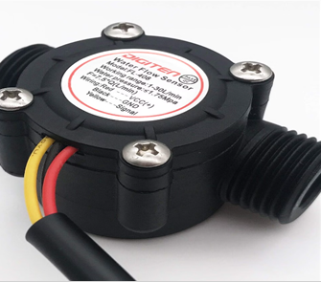
Machine Learning for Predictive Maintenance
Predictive Maintenance
AI models to anticipate equipment failures
Optimized Operations
Reduced downtime, lower maintenance costs
Improved Efficiency
Maximizing water recycling effectiveness
AI-Powered Water Quality Monitoring Systems
Real-time analysis of water quality
Early detection of contaminants
Optimized treatment process
Water Quality Monitoring Tool
Smart Sensors and Real-Time Data Analysis
Data collection
pH, turbidity, salinity, temperature, and more
Data Transmission
Wireless communication to central platform
Data Analysis
AI algorithms for pattern recognition and anomaly detection
Water Flow Sensor
5

Slide 6
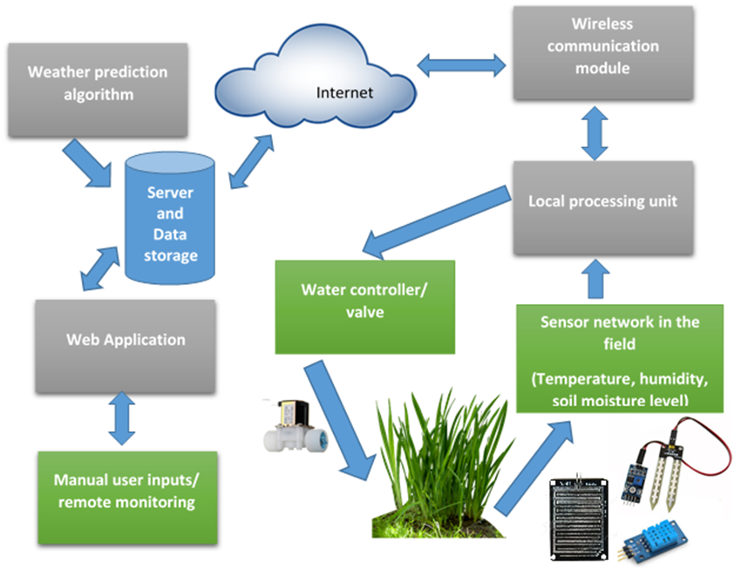
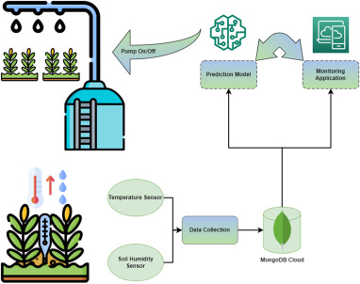
Components of the proposed IOT based smart irrigation system
Proposed Irrigation System
6

Slide 7


Case Study Analysis
Problem Faced
Water scarcity significantly impacts agricultural production.
Solution Offered
AI-driven irrigation with integrated greywater and saltwater recycling.
Benefits
Reduced water usage and increased crop yields.
Approach
1
2
3
4
Prototype
Development
Testing & Optimization
Pilot Deployment
Data Collection
Assess soil conditions & gray water quality
Fine-tune AI algorithms for efficient irrigation
Implement system in controlled agricultural settings
Build IOT &AI-enable filtration system
7

Slide 8
Expected Impact & Benefits
Water Resource Optimization: Reduces freshwater usage in agriculture by 30-50%.
Eco-Friendly Irrigation: Enhances water recycling efficiency while ensuring crop viability.
Economic Efficiency: Reduces irrigation-related costs for farmers through automation.
Environmental Conservation: Mitigates groundwater depletion and prevents harmful runoff.
Cost-Benefit Analysis of AI Implementation
ROI
Significant return on investment within a few years
20% Increased Yield
Improved water quality and crop productivity
50% Reduced Costs
Lower energy consumption and maintenance
8

Slide 9


Challenges in Greywater, Saltwater Filtration, and Irrigation
Problem 1
Filtration Monitoring:
Requires strict oversight to ensure contaminants are fully removed.
Testing Compliance:
Must adhere to safety standards to guarantee water quality for irrigation.
Cost of Implementation:
Advanced filtration systems and infrastructure require significant investment.
Problem 2
Farmer Training:
Comprehensive programs are needed to familiarize farmers with new technologies.
User Interface Design:
Systems must be intuitive for easy integration into daily farming practices.
Adoption Resistance:
Overcoming skepticism and reluctance towards new irrigation and filtration technologies.
9

Slide 10
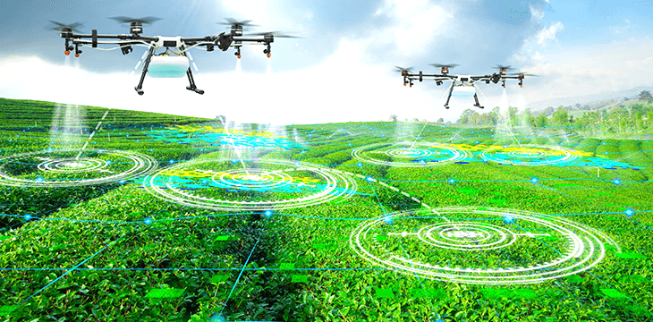

Proposed AI-Driven Irrigation Solution
Advanced Monitoring Systems : Use real-time sensors to ensure effective filtration and water quality.
Standardized Testing Protocols : Implement consistent water quality testing protocols.
Financial Support: Offer subsidies to reduce the cost of system implementation
Farmer Training: Provide hands-on training
to familiarize farmers with new technologies.
User-Friendly Interfaces: Design intuitive systems for easy adoption.
Incentives for Adoption: Promote benefits through pilot programs and success
stories.
10

Slide 11
Future Outlook: Scaling AI
Solutions for Global
Water Security
Enhanced Crop Yields
The system shows improved yields through optimized irrigation methodologies.
AI-powered
water recycling is essential for a sustainable future. It promises to revolutionize irrigation practices,
making water use more efficient
and sustainable.
Reduction of fresh water
Dependence
This approach significantly
minimizes the reliance on limited fresh
water resources
11

Slide 12
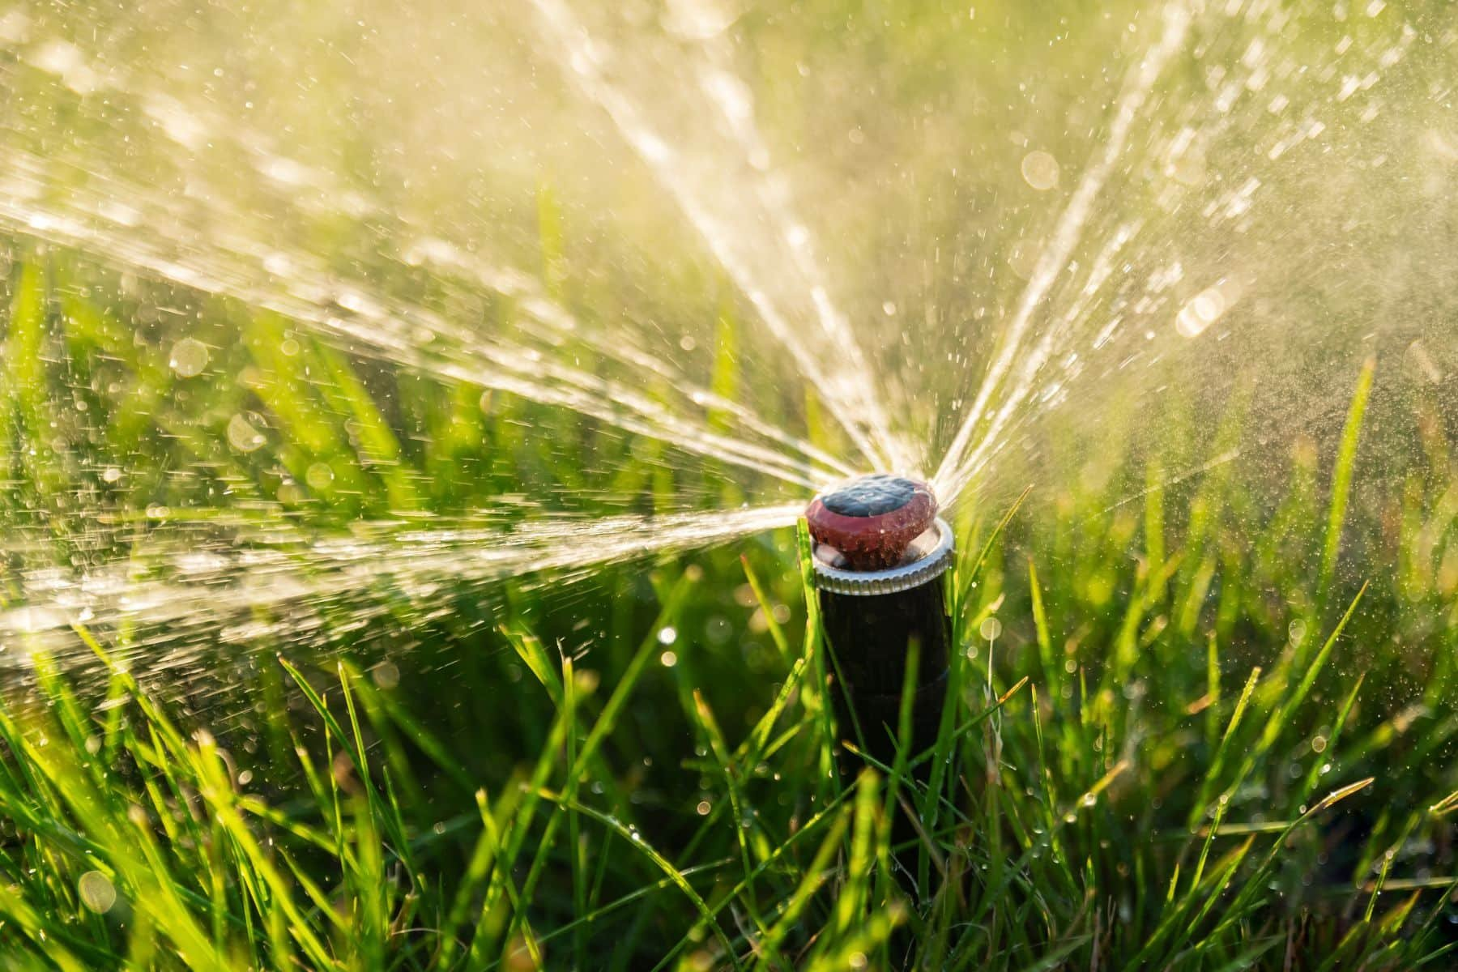
Conclusion
AI-powered irrigation systems play a crucial role in promoting Green living by
- optimizing water usage,
- reducing waste, and
- ensuring sustainable agricultural practices.
By integrating AI with smart sensors, predictive analytics, and greywater recycling, farmers can efficiently manage water resources while maintaining soil health and maximizing crop yield.
This innovative approach not only conserves freshwater but also minimizes environmental impact, supporting global efforts toward sustainability
12

Slide 13

Thank You

